Slide 1
Extended Entity relation diagram
By
Rimjhim Padam Singh,
Asst. Professor,
CSE Deptt.
ASE, Coimbatore

Slide 2
Extended ER Diagram.
Advanced or higher-level database designs.
Extension to basic ER model.
Targets apt representation of complex requirements of high-level and complex databases.
Extended concepts include:
Super-class & Sub-class
Specialization
Generalization
Constraints on Specialization & Generalization.
Category Type or Union
Aggregation

Slide 3
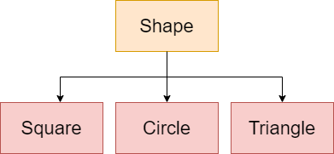
Super-class & Sub-class
Super-class
An entity set that can be further divided into sub-type/ sub-entity sets.
Contains generic features shared by all its sub-entity sets.
Sub-Class
Sub-entity set derived from a generic / super-class based on unique features shared by its entities.
Inherits all the features from its super-class entity set.
Super-class
Sub-classes

Slide 4
Specialization
Specialization is a process of designating sub-groupings with in a high-level entity set.
Each low-level entity-set has specific-attributes and relationships that distinguishes it from rest of the low –level sub-classes.
It is a top down approach.
One entity set is broken down into one or more low-level entity sets.
Also known as ‘IS A’ relationship.
Note:
‘Higher-level’ entity set is also designated as ‘super-class’
‘Lower-level’ entity-set is also designated as ‘sub-class’.

Slide 5
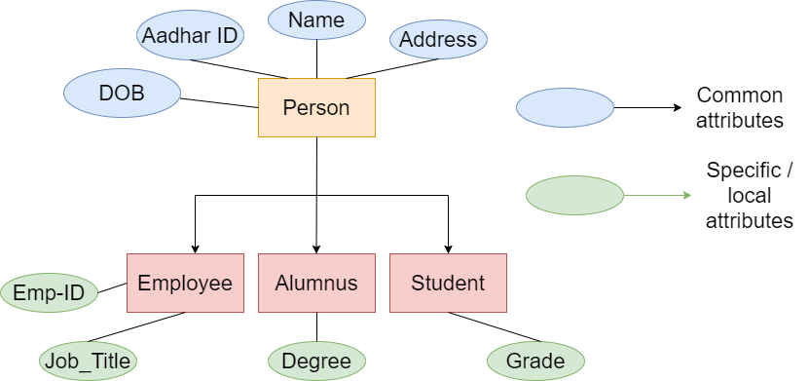
Specialization
Higher-level / super-class
Low-level / sub-class

Slide 6
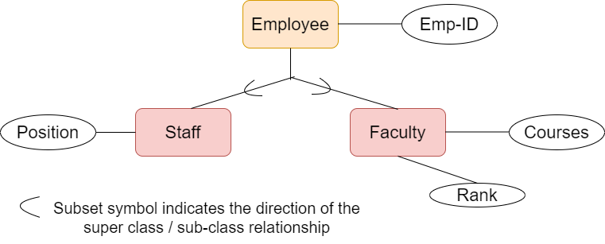
Specialization
The high-level entity set contains common features shared by all specialized entity-sets.
Each low-level specialized entity-set inherits common features from high-level entity-set and adds its own specific features.

Slide 7
Generalization
Multiple entity sets are synthesized to form a higher-level entity-set on basis of common features.
Generalization is a process of building a generalized entity-set from a set of multiple low-level entity-sets by identifying the common features shared amongst them.
Hence, the generalized entity-set contains the identified common features (attributes & relationships)
It is a Bottom Up process.
Reverse of Specialization.
In terms of diagrams, both Generalization and Specialization are represented in similar manner.

Slide 8
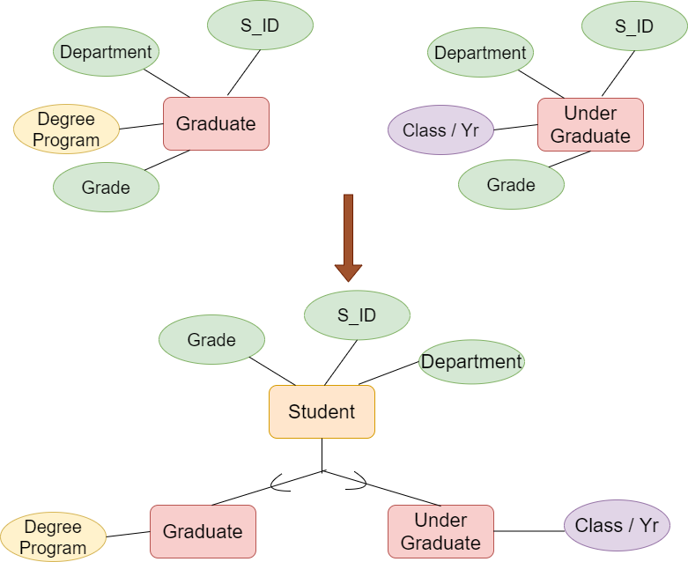
Generalization
Entity Set-1
Entity Set-2
Identify Common features (attributes & relations) and move them to a new higher-level entity set.
Keep unique features as it is.

Slide 9
Generalization

Slide 10
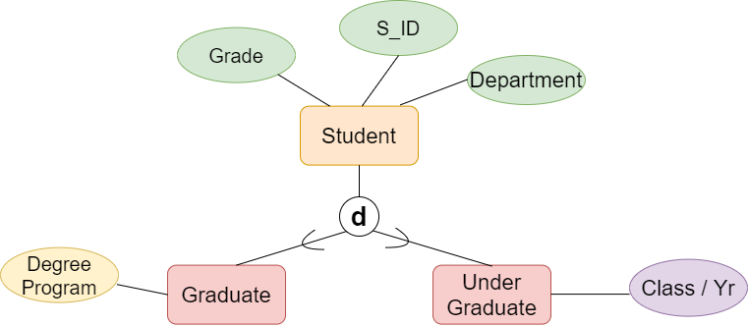
Constraints on Generalization / Specialization
A. DISJOINT CONSTRAINT
Decides whether or not entities may belong to more than one lower-level entity set within a single generalization.
Disjoint: An entity from the higher-level generalized class (super-class) must belong to at most one low-level sub-class or entity-set.
In other words, sub-classes of a specialization must be disjoint

Slide 11
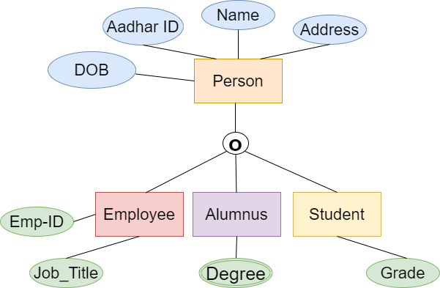
Constraints on Generalization / Specialization
A. DISJOINT CONSTRAINT
Overlapping: An entity from the higher-level generalized class (super-class) can belong to multiple low-level sub-class or entity-set.
In other words, an entity from a super-class can belong to multiple sub-classes of a specialization.
Current employee can be an ex-student.
An employee can be a part-student student.
Alumni of Btech can be pursuing Mtech also

Slide 12
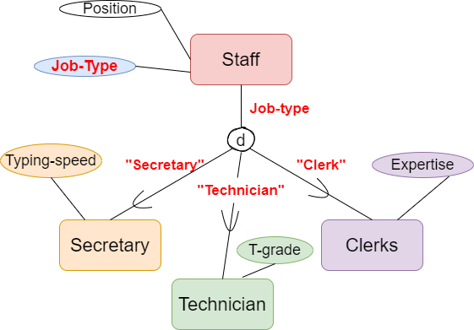
Constraints on Generalization / Specialization
B. CONDITION-DEFINED & USER-DEFINED
Condition-defined low-level entity-sets, membership of an entity is defined on the basis whether or not it satisfies an explicit condition or predicate.
Here, condition is placed on the value of one or more attributes of the super-class.
Also known as ‘Attribute-defined’ / ‘Predicate-defined’ lower-level entity-set or subclass
Condition defined on ‘Job-Type’ attribute of ‘Staff’ class

Slide 13
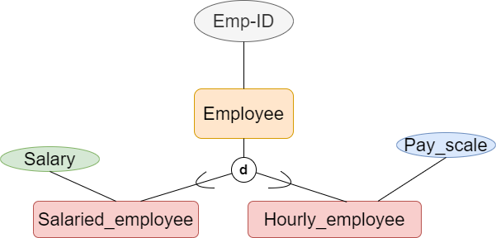
Constraints on Generalization / Specialization
B. CONDITION-DEFINED & USER-DEFINED
User-defined low-level entity-sets, membership of an entity is decided by the database user.
Here, membership is not constrained by any condition.
It depends upon the employer, if the selected employee will be a salaried_employee or an hourly_employee.
Here, Employer has been considered as a database user.

Slide 14
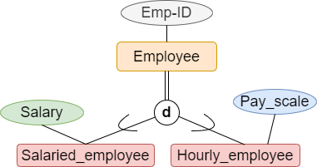
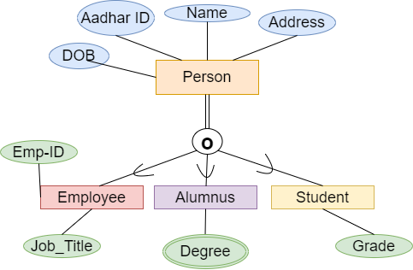
Constraints on Generalization / Specialization
B. COMPLETENESS CONSTRAINT
Specifies whether or not an entity in the higher-level entity-set must belong to at least one of the lower-level entity sets within the generalization/specialization.
Total generalization / Specialization: Each entity from the high-level entity-set must belong to at least one of the low-level entity-sets.
Represented using a double line.

Slide 15
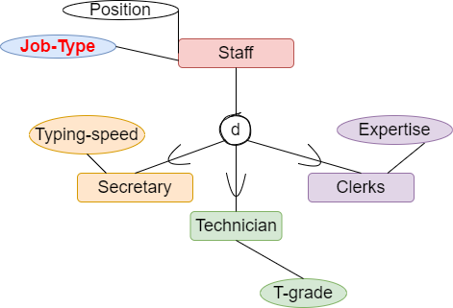
Constraints on Generalization / Specialization
B. COMPLETENESS CONSTRAINT
Partial generalization / Specialization: An entity from the higher-level entity-set may not belong to any of the lower-level entity-sets in a specialization / generalization.
Default is partial generalization / specialization.
Staff entity-set may have partial specialization, if the staff has recently joined and is under training. He will be allotted a sub-class or job after 3 months.
Represented using a single line.

Slide 16
Constraints on Generalization / Specialization
CERTAIN RULES
Deleting an entity from a super-class implies that it is automatically deleted from all the sub-classes.
Inserting an entity in a super-class implies that the entity is mandatorily inserted in all attribute-defined sub-classes for which the entity satisfies the defining predicate.
Inserting an entity in a super-class of a total specialization implies that the entity is mandatorily inserted in at least one of the sub-classes of the specialization.
Disjoint and completeness constraints are independent
We can have following combinations of constraints on specialization
1. Disjoint, Partial
2. Disjoint, Total
3. Overlapping, Partial
4. Overlapping, Total

Slide 17
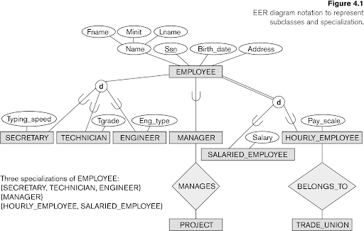
Multiple Specializations for an entity-set
An entity set may be specialized by more than one distinguishing feature.
An entity from higher-level entity set can belong to multiple specializations.
Ex: An employee who is an ENGINEER is also a SALARIED_EMPLOYEE.
A specialization can have single sub-class also. Ex. Manager
Specialization based on Job_type
Specialization based on type of pay

Slide 18
Attribute inheritance and participation inheritance
Crucial property of lower and higher level entity sets created by specialization / generalization.
Attribute inheritance : Attributes of higher-level generalized entity-set are inherited by all its low-level specialized entity sets.
Participation Inheritance: Low-level entity-set inherits participation in the relationship sets in which its higher-level entity (or super-class) participates.
Both Attribute inheritance and Participation inheritance apply through all tiers of low-level entity-sets.

Slide 19
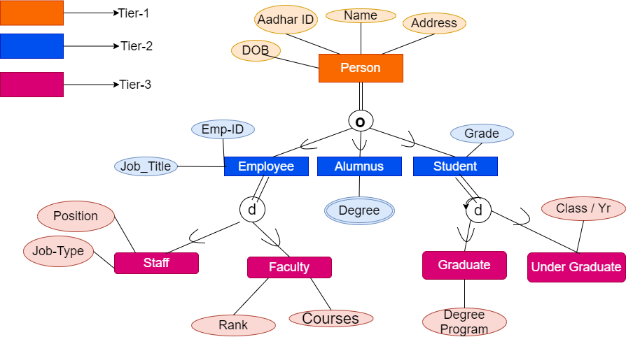
Attribute inheritance and participation inheritance
Attributes and relationships of ‘Person’ Entity-set are inherited by all EMPLOYEE, ALUMNUS, STUDENT, STAFF, FACULTY, GRADUATE AND UNDER-GRADUATE ENTITY SETS

Slide 20
Multiple inheritance
If an entity set is a lower-level entity set and has more than one generalized sets or super-classes , then the entity set has multiple inheritance.
The resulting structure is said to be a specialization lattice.
Ex: ENGINEERING_MANAGER inherits ‘ENGINEER’, ‘MANAGER’ & ‘SALARIED_EMPLOYEE CLASS.’
Sub-class having multiple super-classes is called shared class
RULE: If an attribute (or relationship) originating in the same super-class is inherited more than once via different paths and in the lattice, then it should be included only once in the shared subclass.

Slide 21
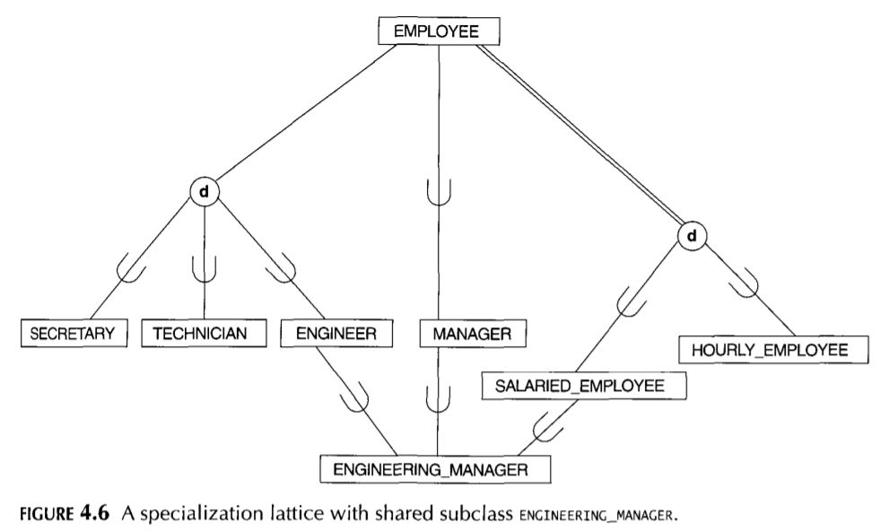
Multiple inheritance
ENGINEERING_MANAGER is a shared class
Attributes of EMPLOYEE class can be inherited via three different paths through ENGINEER , MANAGER and SALARIED_EMPLOYEE.
As per the rule, attributes of EMPLOYEE will be inherited in ENGINEERING_MANAGER class only once.

Slide 22
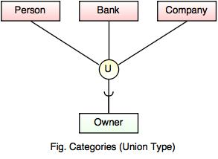
Modelling Union type using categories
Models single super-class / sub-class relationship with more than one super-class.
Lower-level sub-class contains entities from the UNION set of super-classes.
Such sub-class is called a Union type or a Category

Slide 23
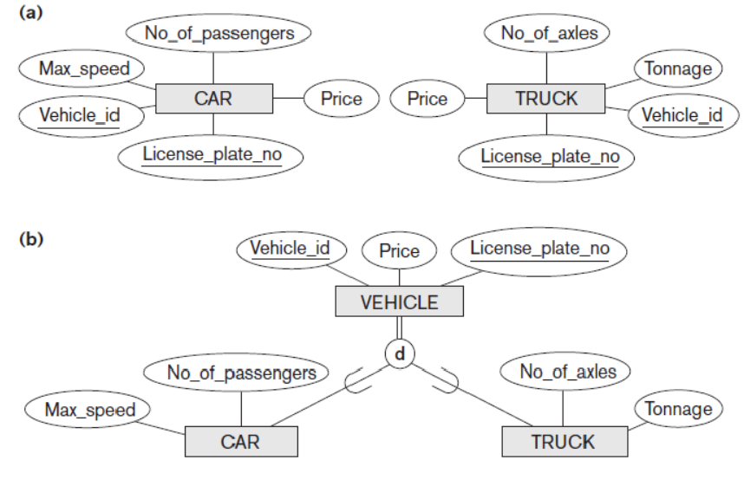
ACTIVITY
Perform generalization

Slide 24
ACTIVITY

Slide 25
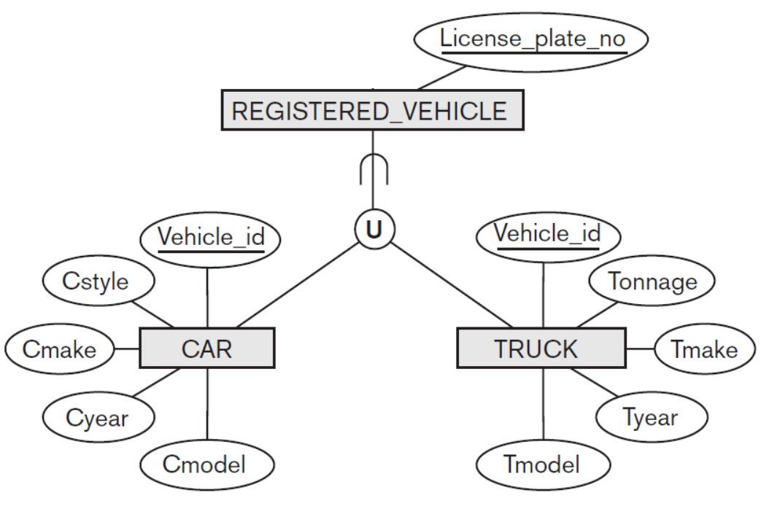
ACTIVITY
Difference between two?

Slide 26
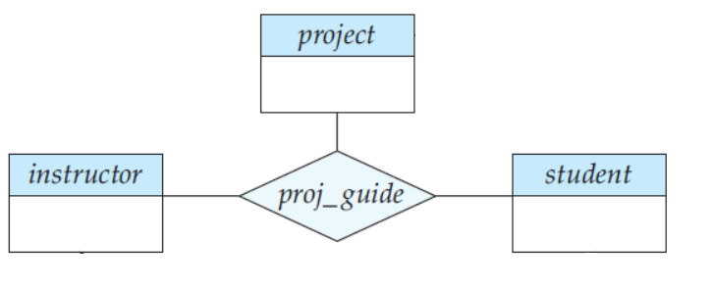
Aggregation
Consider the ternary relationship proj_guide.
Suppose we want to record evaluations of a student by a guide on a project

Slide 27
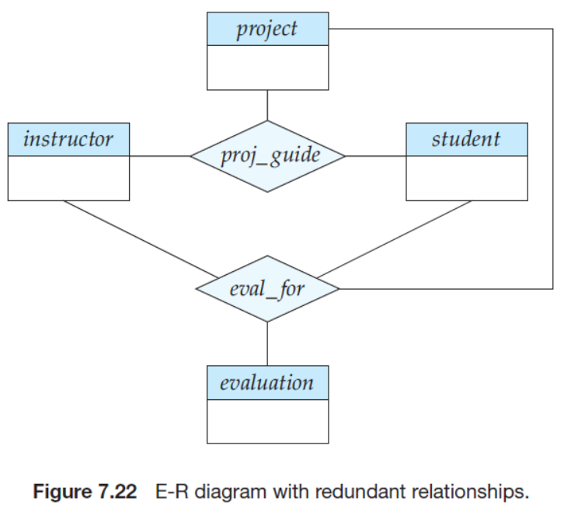
Aggregation
Requires creation of a 4-ary relationship eval_for

Slide 28
Aggregation
Relationship sets eval_for and proj_guide represent overlapping information.
Every eval_for relationship corresponds to a proj_guide relationship.
However, some proj_guide relationship may not correspond to a eval_for relationship.
Hence, discarding proj_guide relationship will lead to loss of information.
Aggregation is required.
Aggregation is an abstraction through which relationships are treated as higher-level entities.

Slide 29
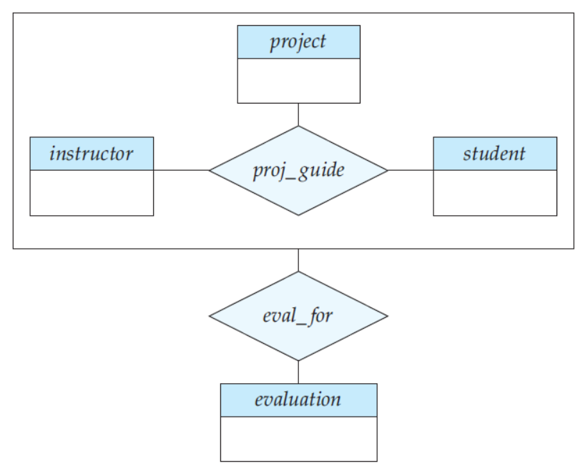
Aggregation
Eliminate redundancy of data using aggregation.
Consider a relationship as an abstract / virtual entity.
Allows establishing relationships between such relationships.
Abstracts the whole relationship as a new entity.

Slide 30
Aggregation
A student is guided by a particular instructor on a particular project.
Student, instructor and project collectively may have an associated evaluation.

Slide 31
Aggregation
Representation:
Schema representing aggregation contains:
Primary key of the aggregated relationship
i.e. (S_ID, project_ID, i_ID)
Primary key of the associated entity set.
say evaluation_ID
Additional descriptive attributes ,if any.
Hence, in this example schema definition is:
(S_ID, project_ID, i_ID, evaluation_ID).

Slide 32
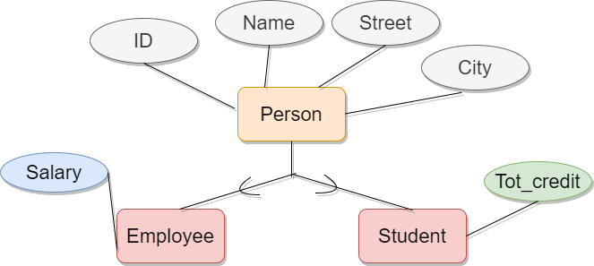
Schema representation
SPECIALIZATION Representation (METHOD-1):
Form a schema for higher-level entity.
Form a schema for each lower-level entity set. Include in this primary key of higher-level entity set and local attributes.
Person (ID, Name, Street, City)
Employee (ID, Salary)
Student (ID, Tot_credit)
Drawback:
Getting information about an Employee requires accessing two relation.

Slide 33
Schema representation
SPECIALIZATION Representation: (METHOD-2
Form a schema for each entity set.
Include all inherited and local attributes.
Person (ID, Name, Street, City)
Employee (ID, Name, Street, City, Salary)
Student (ID, Name, Street, City, Tot_credit)
Drawback:
Name, street and city attributes are stored redundantly for people who are both emploee and student.

Slide 34
Schema representation
AGGREGATION Representation:
Schema representing aggregation contains:
Primary key of the aggregated relationship
i.e. (S_ID, project_ID, i_ID)
Primary key of the associated entity set.
say evaluation_ID
Additional descriptive attributes ,if any.
Example schema definition is:
(S_ID, project_ID, i_ID, evaluation_ID).

